Slide 1
SpaceNet6 Challenge Multi-Sensor All-Weather Mapping
Tan Chuan Xin
2 June 2020 – 7 August 2020

Slide 2
The Challenge

Slide 3
The Challenge
Building footprint extraction using computer vision + artificial intelligence
Dataset: Synthetic Aperture Radar (SAR) and Electro-Optical (EO) data
Test set: only SAR
EO vs SAR
EO: Conventional visible spectrum of light. A lot of work has been done in computer vision for EO images. Limited by weather, vegetation cover
SAR: Radio to Infrared frequencies. Different view of the Earth with SAR. Able to achieve weather, vegetation penetration. Not much research/tools for SAR
Challenge – build a good model for building detection using SAR data

Slide 4
Applications
Humanitarian aid - disaster relief
Use for mapping and navigation
Track changes in landscape
Military – another dimension of vision
Identifying structures that have been built up beneath vegetation
All-weather mapping and surveillance
Target identification

Slide 5
SAR Data

Slide 6
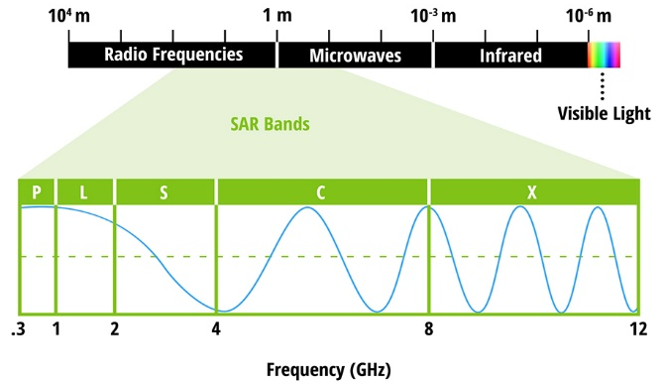
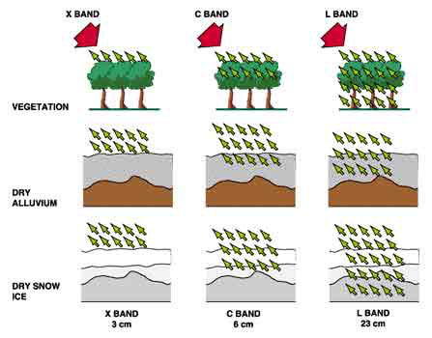
SAR Data
Wavelengths that can be used
Different bands used for different purposes
Penetration through vegetation

Slide 7
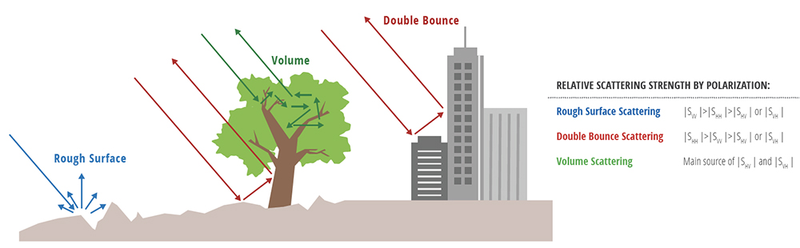
SAR Data
Scattering patterns for different surfaces
Produces reflected signals that vary based on surface topography
Cloud penetration – all weather mapping

Slide 8
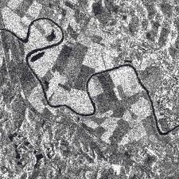
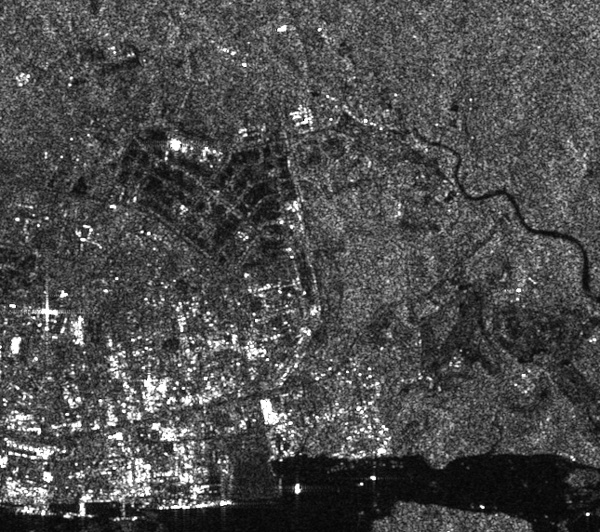
SAR Data
Grainy nature due to scattering and smaller signal strength emitted
Manmade signal, unlike sunlight

Slide 9
The Dataset

Slide 10
The Dataset
Image files
Pansharpened: high resolution, high detail, monochromatic
PS-RGB: pansharpened RGB - RGB images enhanced my PAN images
PS-RGBNIR: pansharpened RGBNIR – extra infrared channel
RGBNIR: raw colour image
SAR-Intensity: quad polarized SAR data
SAR-Orientations
TXT file containing SAR image rotation information
North and South facing flightpaths
Geojson
CSV sheet containing geo information regarding building polygons

Slide 11
The Dataset
train_all
PAN, PS-RGBNIR, PS-RGB, RGBNIR, SAR-Intensity
3401 images for each colouring type
test_all
Available to us, but no ground truth geojson to make use of this
2061 images for SAR-Intensity images only
score_all
Not available to us

Slide 12
The Benchmark

Slide 13
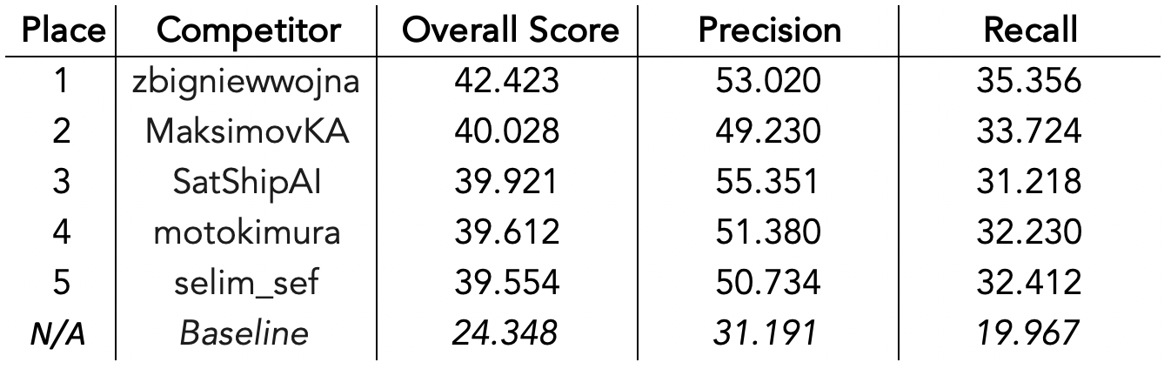
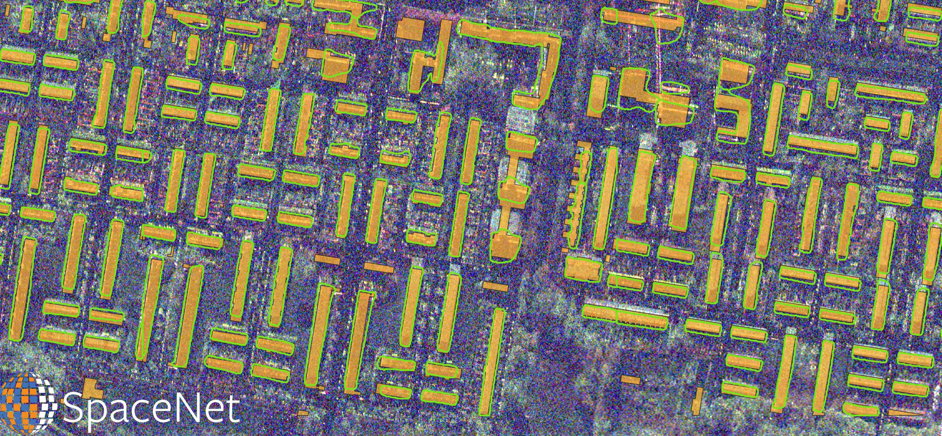
The Benchmark
Performance of the winners:
What a prediction looks like (green: proposal yellow: ground truth)

Slide 14
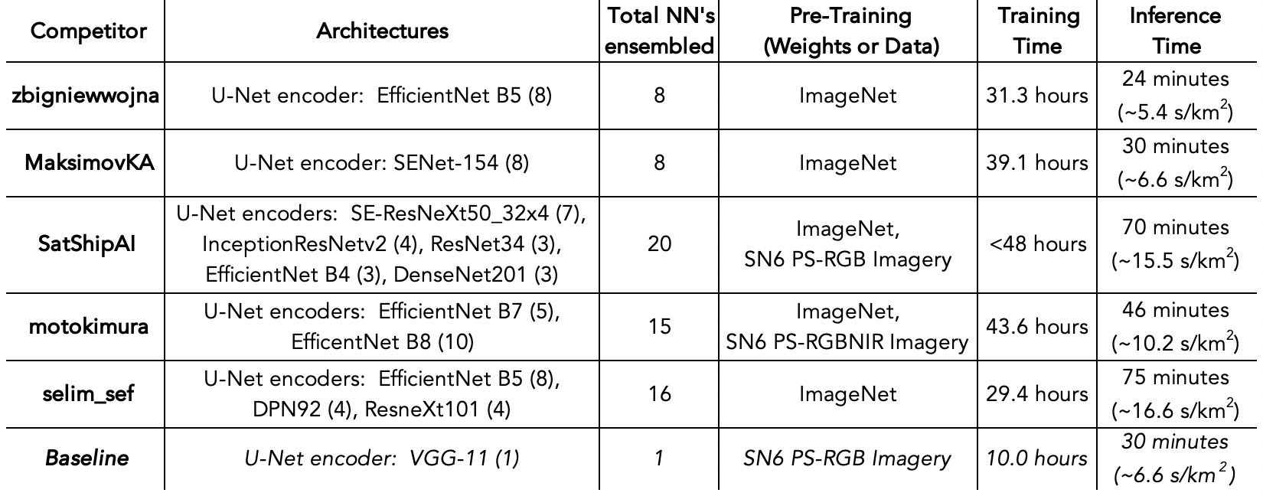
The Benchmark
Some of the architectures used by competition
EfficientNet used by the top competitors

Slide 15
Workflow

Slide 16
Directory
My Drive (Google Drive)
Colab Notebooks
spacenet6
spacenet6_data folder for data of resized, original images
spacenet6_data_BACKUP folder with original images
spacenet6_data_rotated folder for data of resized, rotated images
spacenet6_data_trial folder for data to quickly test things with
metrics_keras_XXX.csv metrics that are stored for various tests
spacenet6_keras_XXX.ipynb working notebooks
TEST_IDX_XXX.npy test indexes used for standardization and comparison
z_spacenet6_keras_XXX.ipynb outdated notebooks

Slide 17
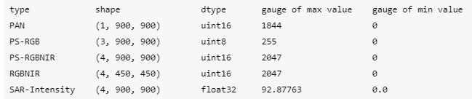
Directory
spacenet6_data_BACKUP
test_all
AOI_11_Rotterdam
SAR-Intensity
train_all
AOI_11_Rotterdam
_mask generated by ourselves
geojson_buildings ground truth file for buildings
PAN
PS-RGB
PS-RGBNIR
RGBNIR
SAR-Intensity
SummaryData ground truth file for buildings, and orientation

Slide 18
Directory
spacenet6_data
IMAGETYPE_HEIGHTxWIDTH folder for images of that specific combination
image image of the folder dimension
mask ground truth mask of the folder dimension
sample sample data based on IDX generated, for standardization
saved_models folder, models and weights generated based on this data
z_outdated no longer in use
spacenet6_data_rotated
Same as spacenet6_data, except the images here are rotated based on the rotation flag

Slide 19
Cloud Computing
Settled on Google Colaboratory for the project
Free GPU usage available
Better, paid option only available in USA
Personal laptop and company laptop too slow
WFH situation
Link to Google Drive, able to upload data and share
Limitations
Speed of GPU dependent on what is available that day
GPU usage limits
Session timeouts
Incompatible with some python modules

Slide 20
Preparation for repetition
Online guides for machine learning almost never saves data for future use, instead favouring generating on the fly
Not suitable for cloud computing with timeout
Not suitable for repeated experiments where only one variable is changed
Slows down process since generating data is time consuming
Prepare data beforehand
Indexes – random indexes generated and saved for various train/test sizes, to be used for consistency during trial and error
Sample data – data based on these random indexes, to be used for consistency during trial and error

Slide 21
Saving results
Metrics file
Save the output metrics for easy cross-notebook comparison of the best result
Model, weight
Save the models and weights to easily recreate the models we need
ID
Use a numerical ID to easily identify the model we want

Slide 22
Journey

Slide 23
Overview of Journey
Fastai
Learning the ropes of deep learning through a relatively simple API built for novices
Experimentation with three_shapes, simple toy example to learn
Learn about unet, segmentation
Exploring spacenet6 data
Various online courses on youtube to learn what the data I am looking at actually is, like scipy online lectures
Experiment with the various files that I have
Set up colab for the project
5 June
11 June
2 June
9 June
Fastai
Learning about data augmentation, utilising fastai framework
Experimentation with three_shapes and puppy, simple toy examples to learn
Data augmentation helps the model learn
Fastai: spacenet6_fastai
Trying to get the spacenet6 challenge data to be well-formed for the fastai framework
Proved to be too much of a hassle to accomplish

Slide 24
Overview of Journey
Switch to TF/Keras
Failure with fastai prompted switch.
Watched several tutorials on deep learning, eventually settled on the TF/Keras framework to move on
Pipeline: spacenet6_masking
Wasting time by not creating a data pipeline in this experimentation stage
Therefore created a data pipeline
18 June
22 June
16 June
19 June
Basic image segmentation: spacenet6_keras_1
Followed the model for data-science-bowl-2018, a cell segmentation problem
Model totally did not work. Learning about creating models and layers in keras through tutorials
satellite_unet model: spacenet6_keras_2
Looked around for new prebuilt models that might work. Found one and got the first non-blank prediction

Slide 25
Overview of Journey
satellite_unet model: spacenet6_keras_3, 4
Experimentation with the other image types, particularly the ones with 4 channels, and SAR that is float32
Finally loaded in all the data and made it well formed
Attempt to smooth data: spacenet6_keras_6
Read several papers about smoothing the speckle data in SAR. Thought it would help, gave it a shot
Didn’t manage to do any meaningful augmentation to SAR data
25 June
1 July
24 June
29 June
Data augmentation: spacenet6_keras_5
Following ideas from earlier, applying transformations to the data I have and hopefully it works better for my model
It failed though
Transfer learning: spacenet6_keras_7
Attempted to do basic transfer learning (pretrained model) for SAR data, but failed due to the model used, and the 4 channel issue

Slide 26
Overview of Journey
segmentation_models: spacenet6_keras_8
Unhappy with satellite_unet performance, plus not able to do transfer learning
Managed to dig out another pre-built module that allows for more flexibility in model backbone, plus transfer learning.
Did a lot of experimentation
Transfer learning: spacenet6_keras_9
Attempts to try and apply transfer learning from PSRGBNIR to SAR. Have not been very successful yet, probably doing it wrong
3 July
8 July
2 July
6 July
Experimentation: spacenet6_keras_9
Ran a lot of tests with various backbones, loss functions, metrics etc to find the best models
Fixing low hanging fruits: spacenet6_keras_10
Sad about failure and trying to fix some easier things like
Creating geo polygons for predicted buildings (skimage)
SAR rotation flags
Rework evaluation metrics (solaris)
Reset the prepared data + pipeline

Slide 27
Overview of Journey
Creating polygons from prediction: spacenet6_keras_10
Tried to identify individual buildings from the predictions that I have
Did not feel productive, since the predictions tend to be blobs sometimes
Shelved for later
Rework pipeline: spacenet6_keras_11
Tried to streamline a bit more, so that we can do trial and error
Explored various models and backbones and data input
Haphazard testing, no good
10 July
16 July
9 July
14 July
Proper evaluation metrics: spacenet6_keras_10
Unable to install solaris, which will be able to help us evaluate our model performance on the spacenet metric
Limitation with colab
Proper testing: spacenet6_keras_12A
EfficientNetb0 selected for simplicity and general effectiveness
Seen from spacenet6_keras_11
Tried rotated and unrotated SAR data
Crazy variance in performance
Early stopping of 5 was too small

Slide 28
Overview of Journey
Proper testing: spacenet6_keras_12B
Tried rotated and unrotated SAR data
Early stopping changed to 15
15 epochs allowed results to stabilise
Somehow, unrotated performed better
Might be a problem of the 800 images that were selected
Proper testing: spacenet6_keras_12D
Trial with different batch size of 8, 4
4 works well
Early stopping 10 works well too
20 July
23 July
17 July
22 July
Proper testing: spacenet6_keras_12C
Feeding normalized SAR data (range 0, 1)
Not much difference after normalization
Proper testing: spacenet6_keras_12E
Trial with different loss function (BinaryFocalLoss)
Previously all JaccardLoss (IOU)
BinaryFocalLoss is not better than JaccardLoss

Slide 29
Overview of Journey
Proper testing: spacenet6_keras_12F
Tried to rework the prebuilt models to add layers/change layers in the model
Could not accomplish it
Rebuilding model is hard
Layer inputs continually mismatch
Proper testing: spacenet6_keras_12F
Still cannot make the model changes work, the prebuilt model is complicated
Or I am bad at it
25 July
28 July
25 July
27 July
Proper testing: spacenet6_keras_12G
Trial with different loss function (DiceLoss)
DiceLoss can afford comparable performance with JaccardLoss
However the Beta varies, 1.75, 1.25, 0.75 were the best but most Betas performed well anyway
Proper testing: spacenet6_keras_12H
Trial with different loss function (BinaryCrossEntropy)

Slide 30
Overview of Journey
Proper testing: spacenet6_keras_12I
Trial with ResNet50
Four loss functions
This is the best performing model found to date
Prepared notebooks, slides, results for presentation
Proper testing: spacenet6_keras_12I
Trial with EfficientNetB5
Four loss functions
Prepared notebooks, slides, results for presentation
30 July
3 August
29 July
1 August
Proper testing: spacenet6_keras_12I
Trial with EfficientNetB3
Four loss functions
Prepared notebooks, slides, results for presentation
Proper testing: spacenet6_keras_12I
Trial with ResNet152
Four loss functions
Prepared notebooks, slides, results for presentation

Slide 31
Overview of Journey
Proper testing: spacenet6_keras_12I
Fix packages breaking, following Colab update
Prepared notebooks, slides, results for presentation
Clean up final work
5 August
7 August
4 August
6 August
Presentation day
Last day

Slide 32
findings

Slide 33
findings
Image rotation
Official competition suggests rotation should help
Own testing with 800 images suggests not rotating is better
Might be because of the 800 images specifically, perhaps using all 3401 images, rotation will be better
Model input
EfficientNetB0 can take float32 values
Normalizing this does not help
Batch size
Smaller batch size learns faster, and produces a better evaluation score
Tried batchsize=16, 8, 4 and 4 was the best

Slide 34
findings
Early stopping
Patience=10 is a good compromise to ensure the model has almost reached its learning limit
Usually models complete learning on the 800-image data set by around 20-40 epochs
Loss functions
JaccardLoss(), DiceLoss() perform very well
BinaryCELoss() performs randomly – very well or normal
BinaryFocalLoss() performs best with ResNet50
alpha=0.75, gamma=0.75 seems to be the best out of all the alpha-gamma combinations
Backbones
ResNet is the best
ResNet50 performs the best out of all the model backbones. With all four loss functions, ResNet50 outperformed all the other backbones.
ResNet152 was a close second
EfficientNetB3 > EfficientNetB5 > EfficientNetB0
More would be tested, but time constraints

Slide 35
Final Working Code

Slide 36
What you should use
spacenet6_masking.ipynb
This is used to create the _mask folder under the train_all directory. It is a step that is used to prepare the masks based on geojson files and image files
spacenet6_keras_12X_SAR_trail_XXX.ipynb
These notebooks are used for the experiments with 800 SAR images
Don’t overwrite the notebook outputs
metrics_keras_12.csv
This stores the metrics that the various 12 series notebooks output
TEST_IDX_XX.npy
These are various indexes that have been generated for standardized trial-and-error
Can ignore if you wish
internship_notebook.ipynb
This is a consolidated notebook for you to experiment as you wish with my work

Slide 37
Notebooks
Check out them notebooks ☺
spacenet6_masking.ipynb
https://colab.research.google.com/drive/16bQy7afyuHE6xiG0fcGYstM1F78Jg631
internship_notebook_guide.ipynb
https://colab.research.google.com/drive/1Rdjtq9fbFC1LM-_9N6vyL91tct-L-COp
internship_notebook_results_summary.ipynb
https://colab.research.google.com/drive/1113OY4iYXrHWgvOVjfagUNK9tgwHTDsU
spacenet6_keras_12I_SAR_trial_backbone.ipynb
https://colab.research.google.com/drive/1Bvcjm_QCL8ZXdv_NrUvrVNbPyPgG8Pro

Slide 38
Problems faced

Slide 39
Problems faced
Learning
Satellite images – EO and SAR
Deep learning
Fastai, pytorch, tensorflow
Image classification, image segmentation
Cloud computing
Optimization and organization
Adapting
Weird internship experience
Resources
Cloud computing
Waiting

Slide 40
Moving Forward

Slide 41
Moving forward
Will transfer learning from EO images help?
How to make the model try and predict along geometric shapes of buildings?
How to help the model separate the tiny buildings
How to reduce the instances of models of model failing due to various reasons
Blobby predictions
Small, sparse and cannot predict
Fine building details
Blank turning up something
Something turning up blank (might be the most important to reduce)
Big misses
How to modify the model?
Prebuilt models were used in the project thus far, but extremely hard to customize. In fact, still unable to customize it

Slide 42
Thank you
Any questions? No promises I can answer ☺

